Slide 1
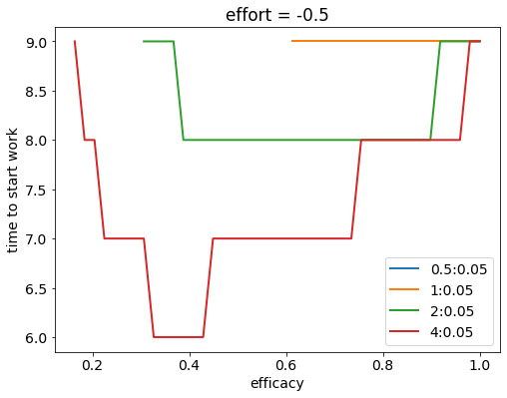
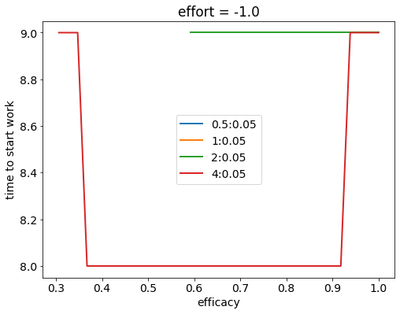
N = 10 and discount factor = 0.9 (always)
Punishment = 0;
Only reward for task completion (and smaller reward for distraction)

Slide 2
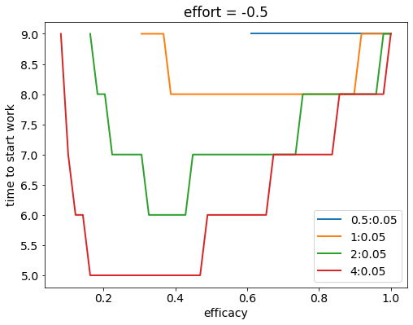
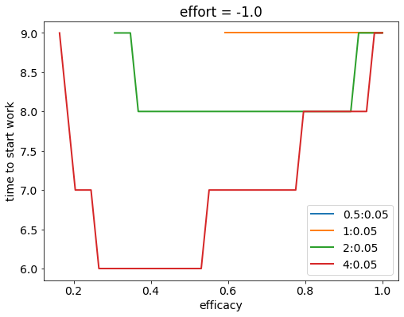
Punishment = -Reward (on task completion);
(and smaller reward for distraction)

Slide 3
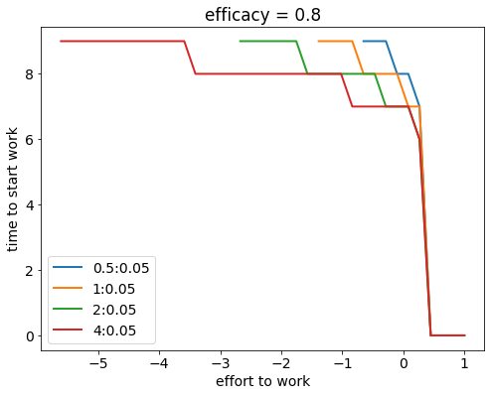
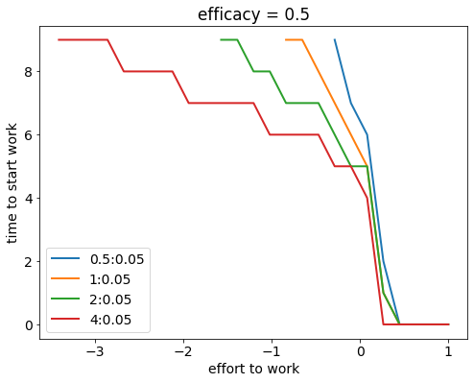
Effects of effort (reward = punishment magnitude)

